Slide 1

First Term Project(1)
`
My page: https://www.learn-in-depth-store.com/profile/abdallahghazal60/profile
Name: Abdullah Mahmoud ghazal
My LinkedIn: https://www.linkedin.com/in/abdullah-ghazal-364117247/

Slide 2
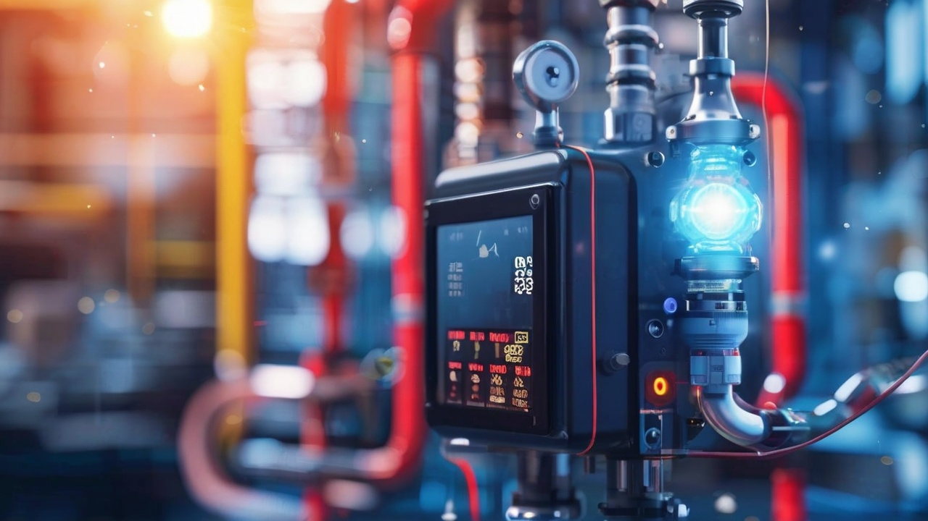
Pressure Controller

Slide 3
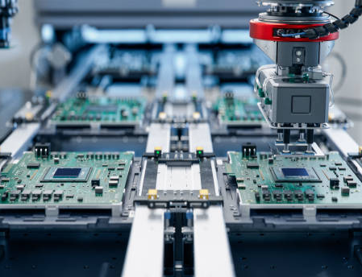
Overview:
1- Case Study
2- Method
3- Requirements
4- Space Exploration
5- System Analysis
6- System Design

Slide 4

Case Study
- Specification (from the client):
1) A pressure controller informs the crew of a cabin with an alarm
2) when the pressure exceeds 20 bars in the cabin.
3) The alarm duration equals 60 seconds.
4) keeps track of the measured values.
- My Assumptions:
1) The controller set up and shutdown procedures are not modeled.
2) The controller maintenance is not modeled.
3) The pressure sensor never fails.
4) The alarm never fails.
5) The controller never faces a power cut.

Slide 5
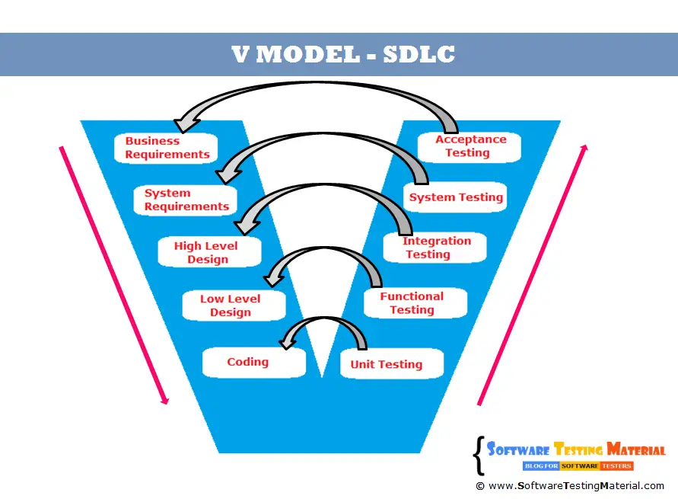
Method
- I would work with the Vmodel method to apply my system design.

Slide 6
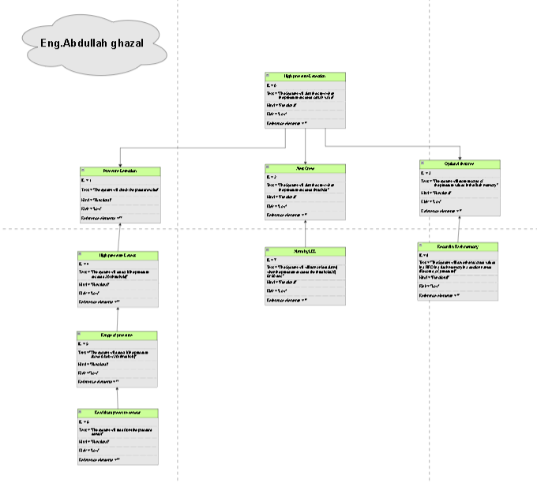
Requirements

Slide 7
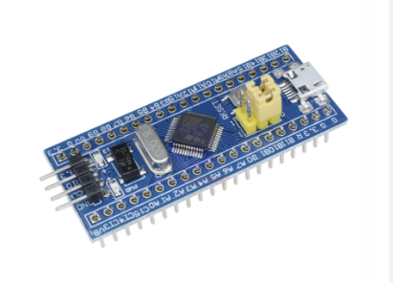
Space Exploration
the Board "STM32F103C8T6 (Cortex_M3) " is Very suitable for this Case study.
o Core: 32-bit ARM Cortex-M3 CPU, running at up to 72MHz
o Memory: 64 KB of Flash memory and 20 KB of SRAM.
o Power: Operates from a 2.0 to 3.6 V power supply and includes several power-saving modes.
o Peripherals: Includes two 12-bit ADCs, three general purpose 16-bit timers, one PWM timer, and various communication interfaces like I2C, SPI, USART, USB, and CAN.

Slide 8
System Analysis
1- Use case 2- Activity Diagram 3- Sequences Diagram

Slide 9
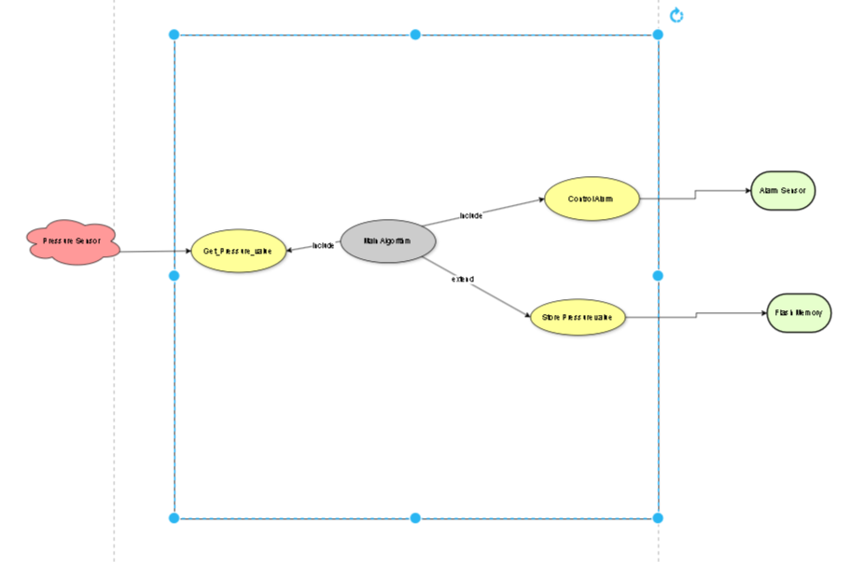

1) Use case

Slide 10
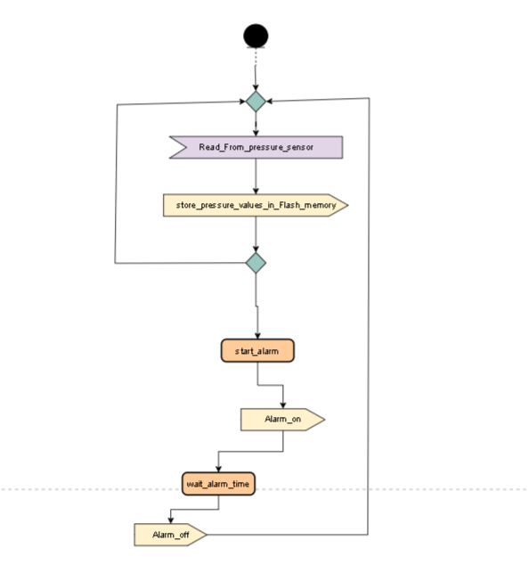
2- Activity Diagram

Slide 11
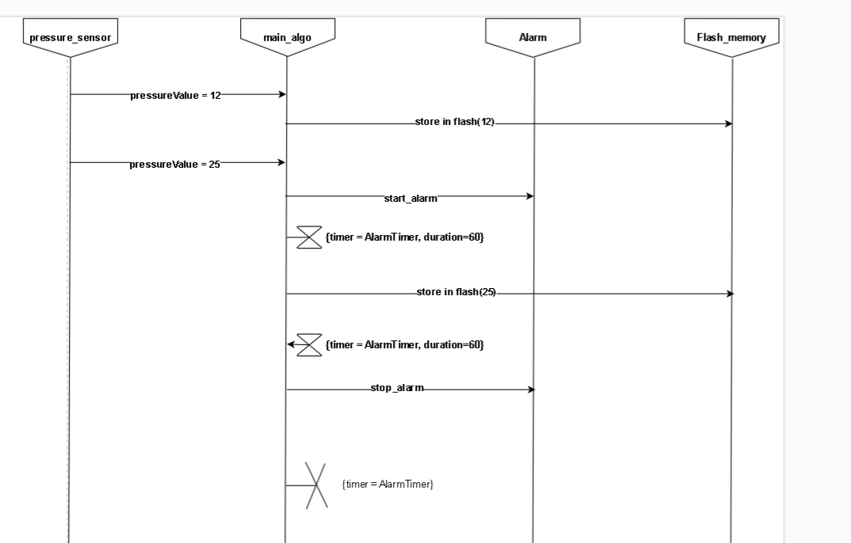
Sequence Diagram

Slide 12
System Design
1- Block Diagram 2- Pressure Sensor 3- Main Algorithm 4- Alarm Actuator

Slide 13
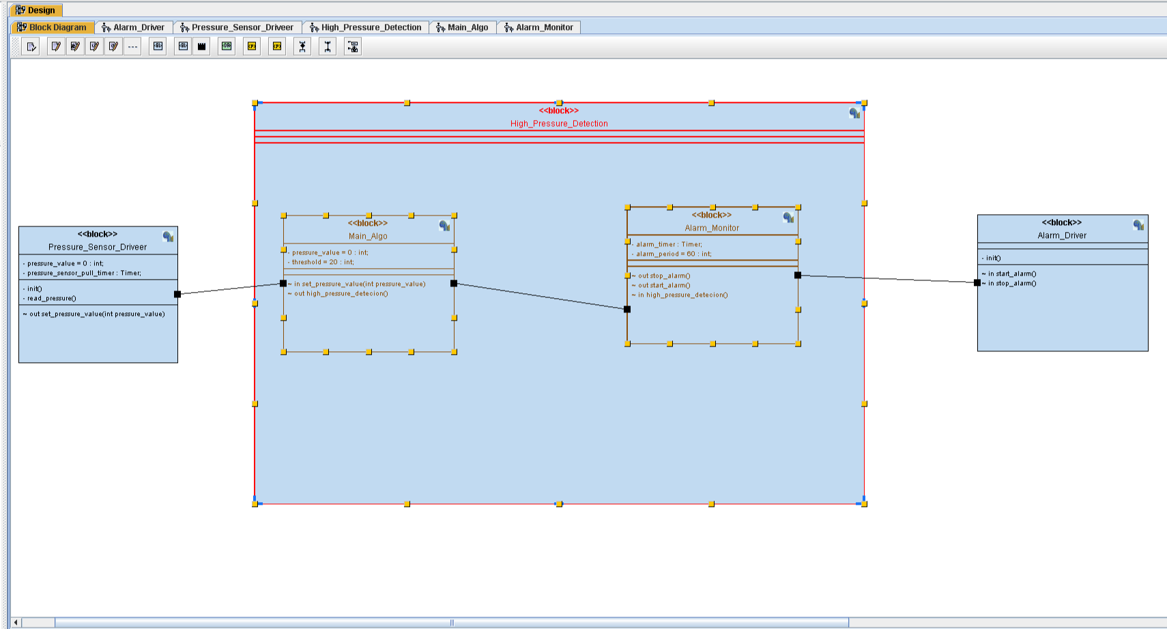
1-Block Diagram:-

Slide 14
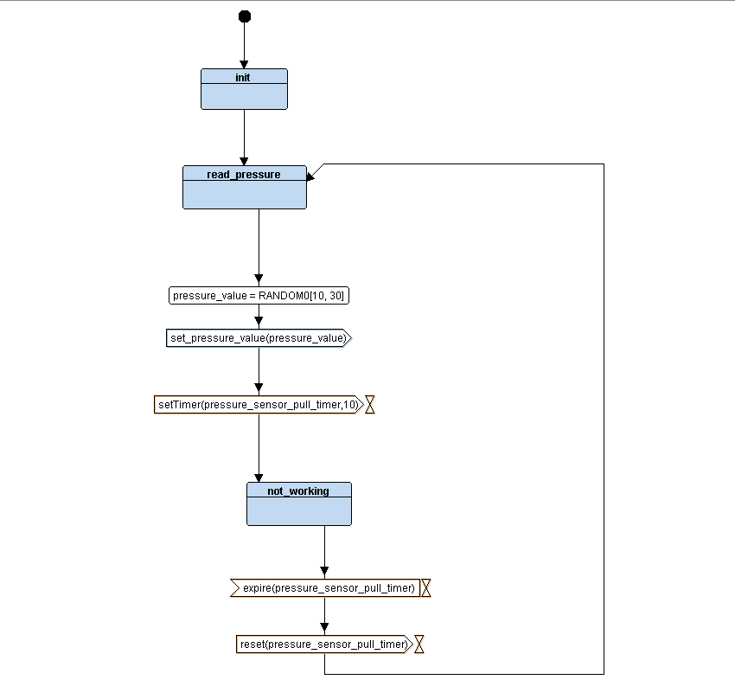
2- Pressure Sensor

Slide 15
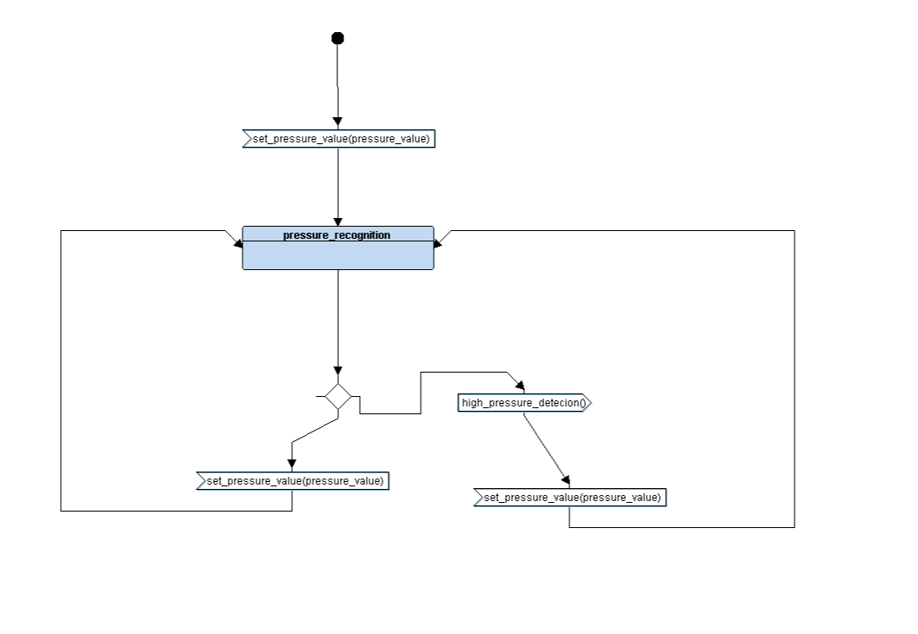
3- Main Algorithm

Slide 16
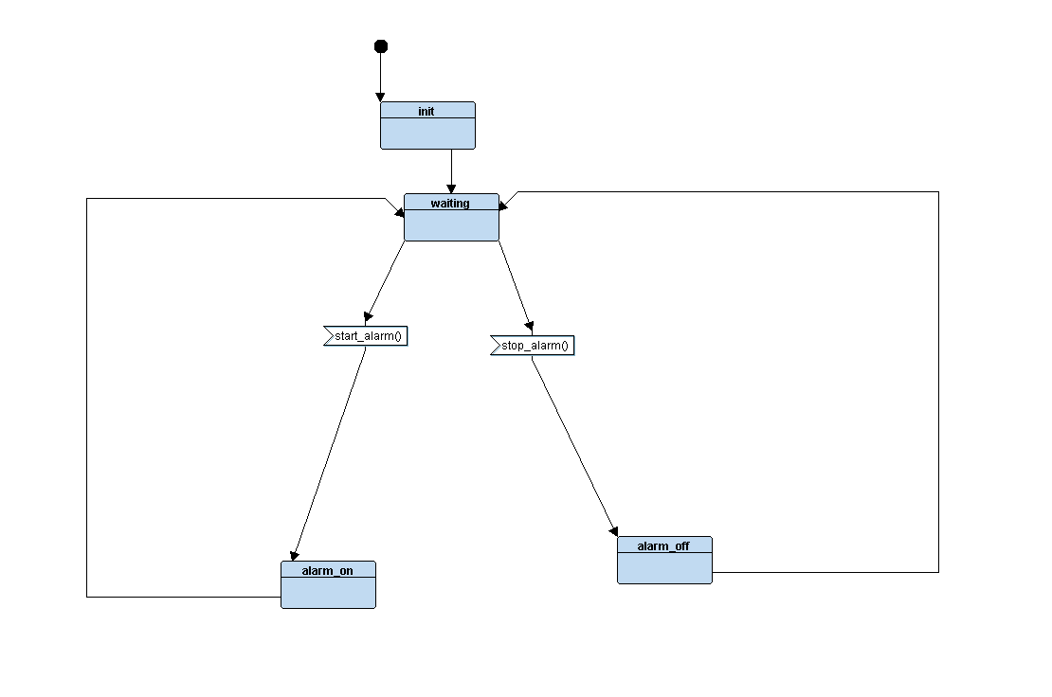
4- Alarm Driver:

Slide 17
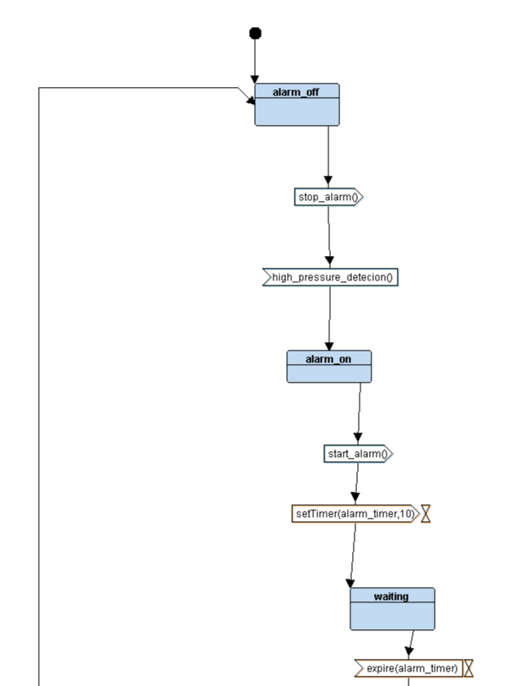
5- Alarm Monitor

Slide 18
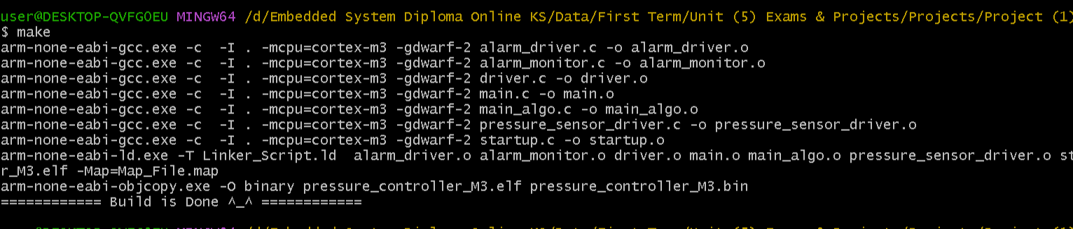
Building Process

Slide 19
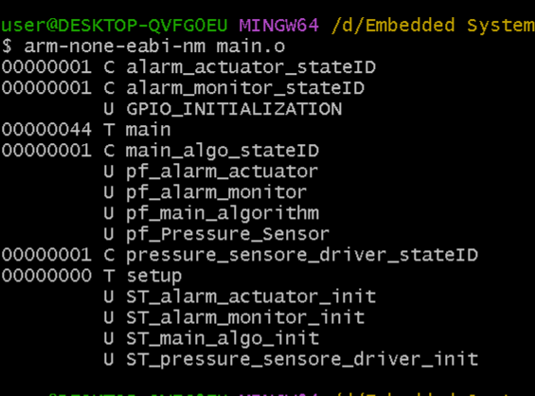
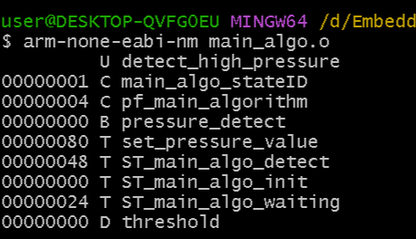
Symbol Tables:-
Main_algo
main

Slide 20
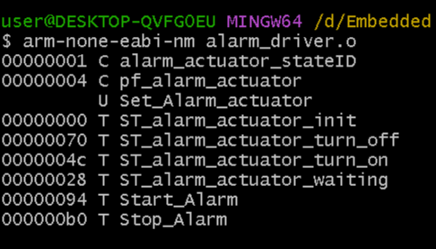
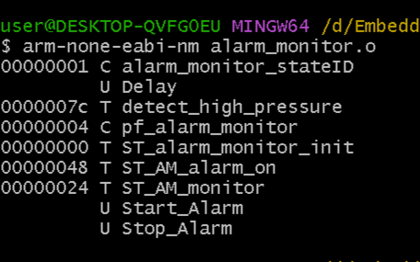
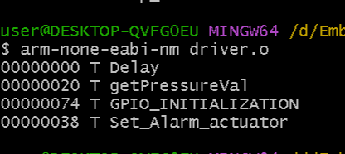
Alarm_Driver
Alarm_monitor
Driver

Slide 21
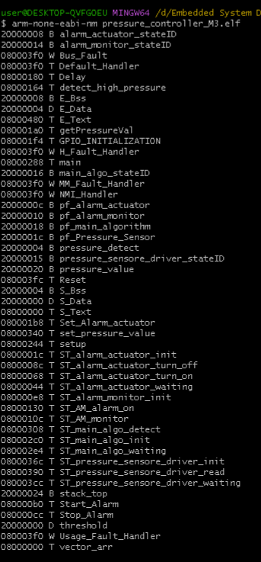
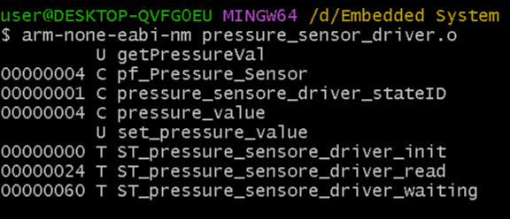
Pressure_sensor_controller
pressure_controller

Slide 22
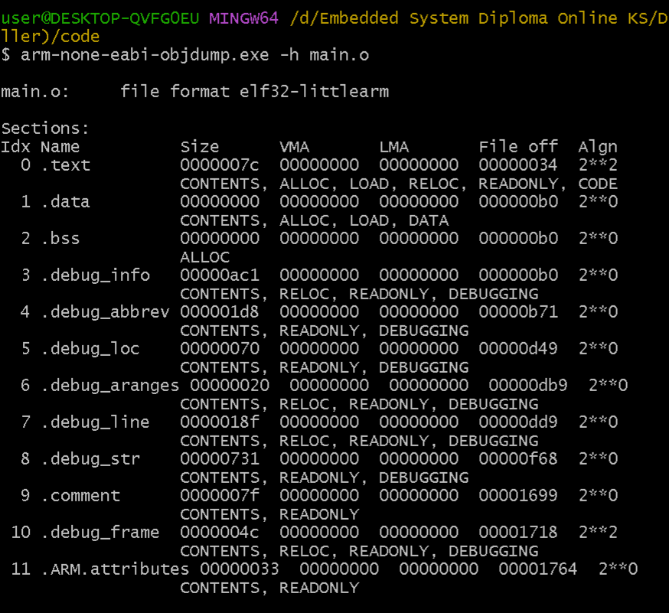
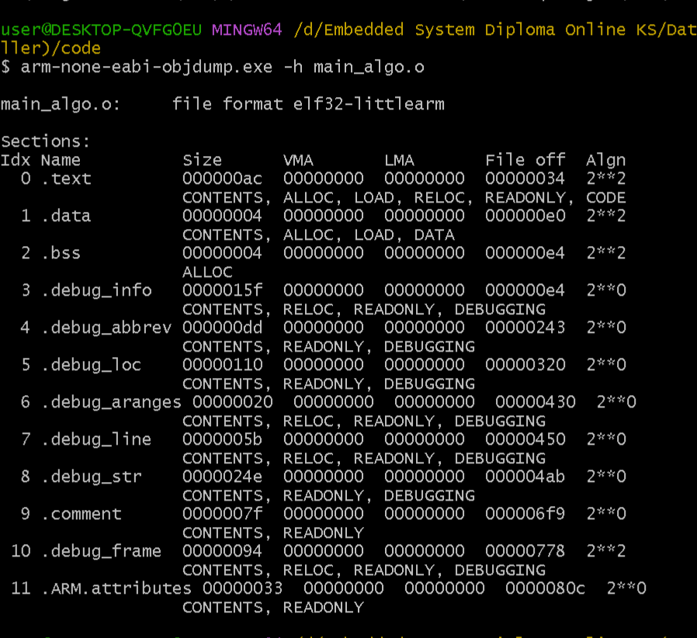
Section_Tables
main
Main_algo

Slide 23
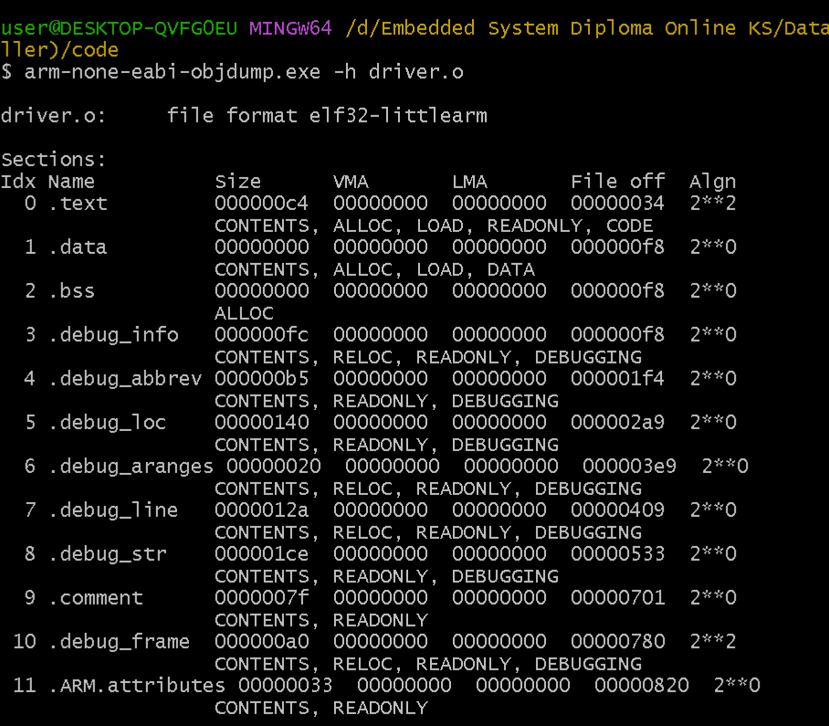
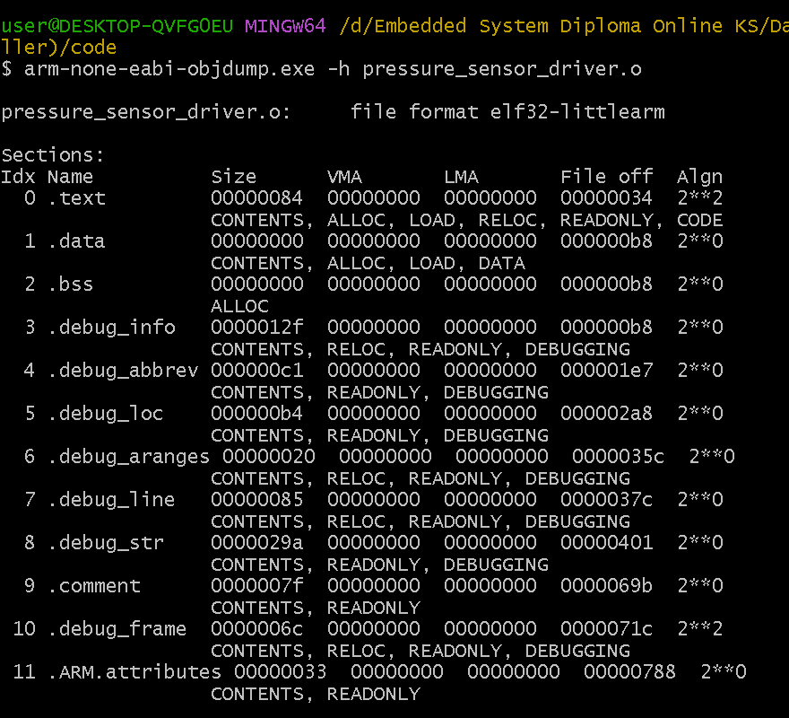
driver
Pressure_sensor_Driver

Slide 24
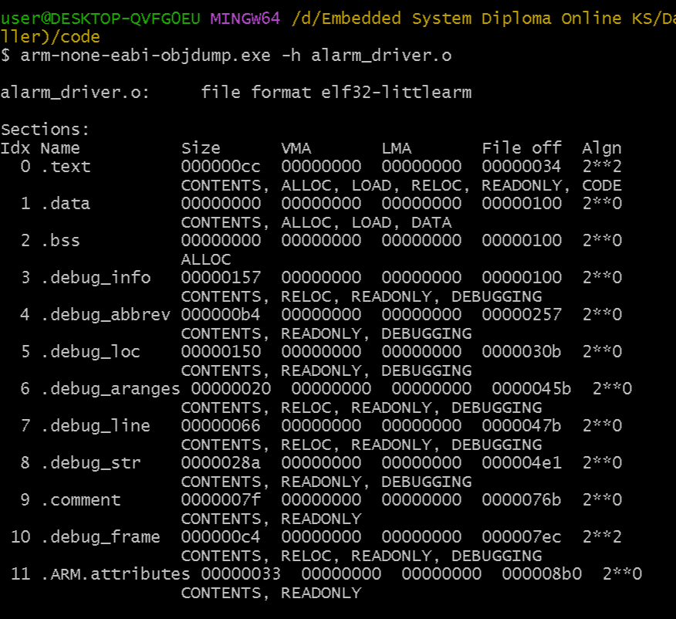
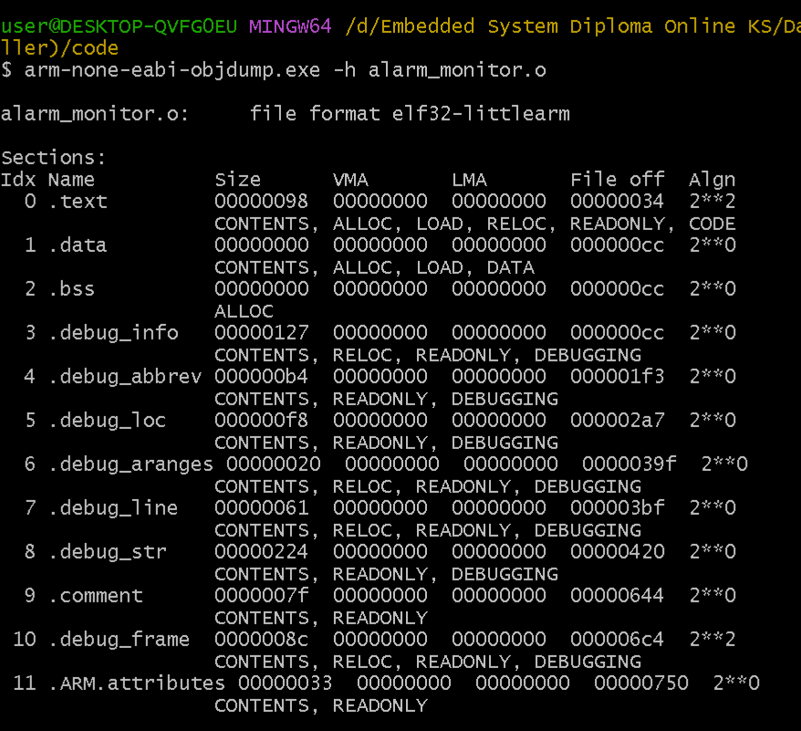
Alarm_driver
Alarm_monitor

Slide 25
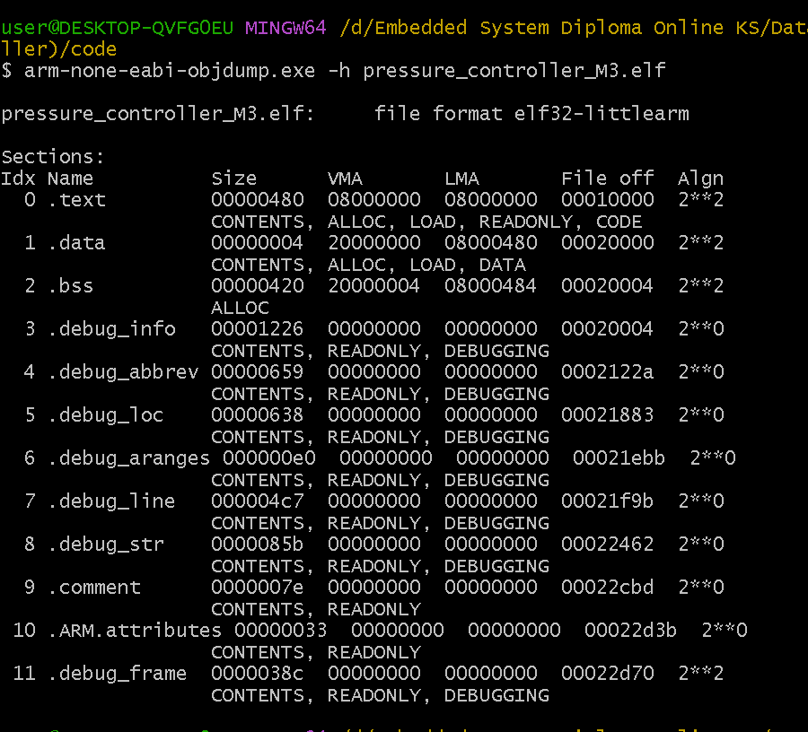
Pressure_Controller

Slide 26
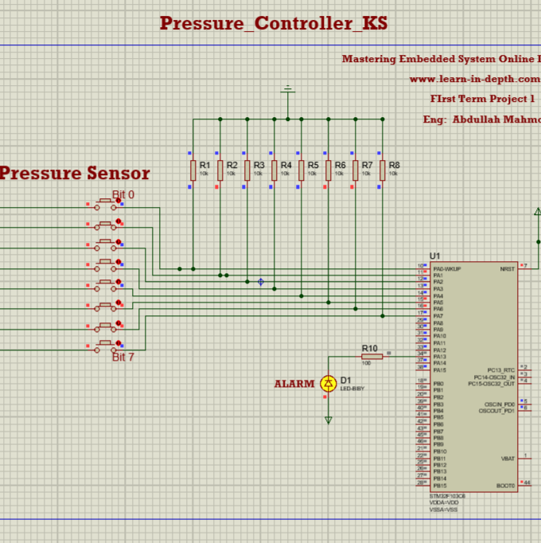
Simulation:-

Slide 27


